Slide 1
1:1-12

Slide 2
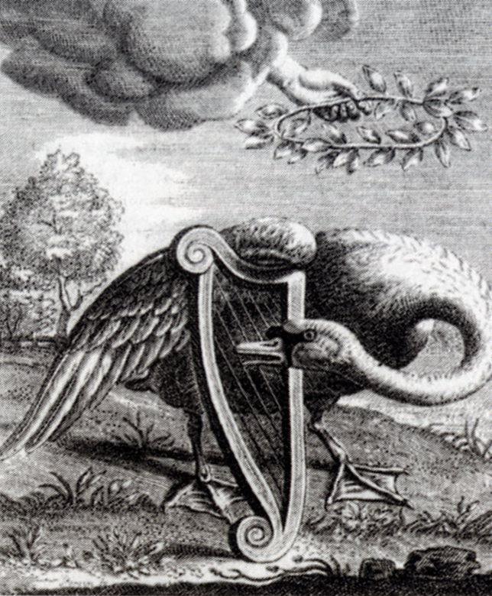
1:1-12
Swan song : a person’s final public performance or professional activity before retirement. “He has decided to make this tour his swan song.”
painting by
Reinier van Persijn (1655)

Slide 3
1:1-12

Slide 4
1:1-12
2 Timothy 1:1-12 ~ ¹ Paul, an apostle of Jesus Christ by the will of God, according to the promise of life which is in Christ Jesus,
² To Timothy, a beloved son:
Grace, mercy, and peace from God the Father and Christ Jesus our Lord.
³ I thank God, whom I serve with a pure conscience, as my forefathers did, as without ceasing I remember you in my prayers night and day, ⁴ greatly desiring to see you, being mindful of your tears, that I may be filled with joy, ⁵ when I call to remembrance the genuine faith that is in you, which dwelt first in your grandmother Lois

Slide 5
1:1-12
2 Timothy 1:1-12 ~ and your mother Eunice, and I am persuaded is in you also. ⁶ Therefore I remind you to stir up the gift of God which is in you through the laying on of my hands. ⁷ For God has not given us a spirit of fear, but of power and of love and of a sound mind.
⁸ Therefore do not be ashamed of the testimony of our Lord, nor of me His prisoner, but share with me in the sufferings for the gospel according to the power of God, ⁹ who has saved us and called us with a holy calling, not according to our works, but according to His own purpose and grace which was given to us in Christ Jesus before time began,

Slide 6
1:1-12
2 Timothy 1:1-12 ~ ¹⁰ but has now been revealed by the appearing of our Savior Jesus Christ, who has abolished death and brought life and immortality to light through the gospel, ¹¹ to which I was appointed a preacher, an apostle, and a teacher of the Gentiles. ¹² For this reason I also suffer these things; nevertheless I am not ashamed, for I know whom I have believed and am persuaded that He is able to keep what I have committed to Him until that Day.

Slide 7
1:1-12

Slide 8
1:1-12
My mother taught me TO APPRECIATE A JOB WELL DONE –
“If you’re going to kill each other, do it outside – I just finished cleaning in here!”
My mother taught me about FAITH –
“You better pray that will come out of the carpet.”
“It looks as if a tornado swept through this room.”
My mother taught me about the WEATHER –
My mother taught me about CONTORTIONISM –
“Will you just look at the dirt on the back of your neck!”

Slide 9
1:1-12
“You’ll sit there ‘til all that spinach is finished.”
My mother taught me about STAMINA –
My mother taught me about TIME TRAVEL –
“If you don’t straighten up, I’m going to knock you into the middle of next week!”
My mother taught me LOGIC –
“Because I said so, that’s why.”
“Make sure you wear clean underwear, in case you’re in an accident.”
My mother taught me PREPAREDNESS –

Slide 10
1:1-12
My mother taught me about the science of OSMOSIS –
Shut your mouth and eat your Brussels Sprouts!”
My mother taught me THE CIRCLE OF LIFE –
“I brought you into this world, and I can take you out.”
My mother taught me about GETTING SOMETHING FOR NOTHING –
“You want something to cry about? I’ll give you something to cry about!”
“There are millions of less fortunate children in this world who don’t have wonderful parents like you do!”
My mother taught me about ENVY –

Slide 11
1:1-12

Slide 12
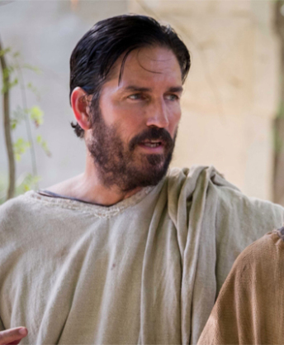
1:1-12
2 Timothy
Philemon, Colossians, Ephesians, and Philippians
Traveled to Macedonia, Asia Minor and (possibly) Spain
Martyrdom
AD 61
AD 62
AD 63
AD 64
AD 65
AD 66
AD 67
Paul’s 1st imprisonment
Paul’s 2nd imprisonment
1 Timothy
Titus

Slide 13
1:1-12

Slide 14
1:1-12
genuine ~ anupokritos – unhypocritical
grandmother ~ mammē; Lois ~ agreeable
mother ~ mētēr; Eunice ~ good victory

Slide 15
1:1-12

Slide 16
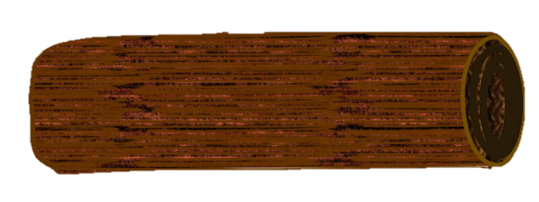
1:1-12
1 Tim. 4:14 ~ Do not neglect the gift that is in you, which was given to you by prophecy with the laying on of the hands of the eldership.
stir up ~ anazōpureō
ana ~ re-, again
zōon ~ living being
pur ~ fire
NIV ~ fan into flame
gift ~ charisma – grace gift

Slide 17
1:1-12

Slide 18
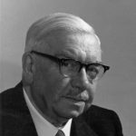
1:1-12
fear ~ deilia – Most modern versions, timidity – better, cowardice
sound mind~ NIV, self discipline
sōphronismos ~ literally “sober midriff”
1) The Spirit gives us power to love;
2) 1 John 4:18 ~ perfect love casts out fear
3) Sober-mindedness is the result
Donald Gee ~ “Better to have a little excess than to be dead …
Donald Gee (1881-1966)
because it’s easier to correct excess than to raise the dead.”

Slide 19
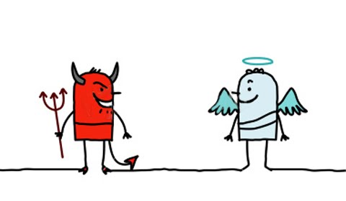
1:1-12
Hello,
my name is “Fear”
You can call
me “Sound mind”
My name is “Power”
And I am “Love”

Slide 20
1:1-12
And I’m
the spirit of “Procrastination”
I’m the spirit of “Christmas”
My friends call me “Team”
My name is “St. Louis”

Slide 21
1:1-12

Slide 22
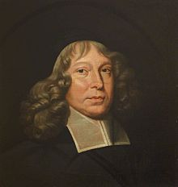
1:1-12
Samuel Rutherford ~ “If you were not strangers here, the hounds of the world would not bark at you.”
Samuel Rutherford
(c1600-1661)

Slide 23
1:1-12

Slide 24
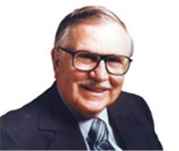
1:1-12
J. Vernon McGee ~ “Man cannot be saved by perfect obedience, because he is incapable of rendering it.
He cannot be saved by imperfect obedience, because God will not accept it.”
1 John 4:8, 16 ~ God is love (agapē)
J. Vernon McGee
(1904-1988)

Slide 25
1:1-12
1 Corinthians 13:4-8
What love is/does:
What love isn’t/doesn’t:
patient
-
1
1
jealous
will not
2
kind
2
boastful
agape
3
rejoices in truth
3
proud
4
bears all things
4
rude
5
believes all things
5
demand its own way
6
hopes all things
6
irritable
7
endures all things
7
keep a record of wrongs
8
rejoice in evil
9
fail

Slide 26
1:1-12

Slide 27
1:1-12
abolished ~ katargeō
kata (according to) + a (un-) + ergon (work)
i.e. to render powerless

Slide 28
1:1-12

Slide 29
1:1-12
Preaching tells you what to do (from a word meaning “proclaim”)
Teaching tells you how to do it (from a word meaning “instruct”)

Slide 30
1:1-12

